Slide 1
Open-Source Maintainers
vs. The CVE Tsunami
Madelyn Olson
Harkrishn Patro
Valkey maintainer
Valkey maintainer
Notes:
This year has been very interesting for all the open source projects in terms of security. Tsunami of CVE requests hitting the maintainers constantly. I, Harkrishn Patro, Valkey maintainer joined by Madelyn Olson, a Valkey maintainer as well. We’re here to talk about how we went about the onslaught of CVEs and came out of it stronger, better, faster.

Slide 2
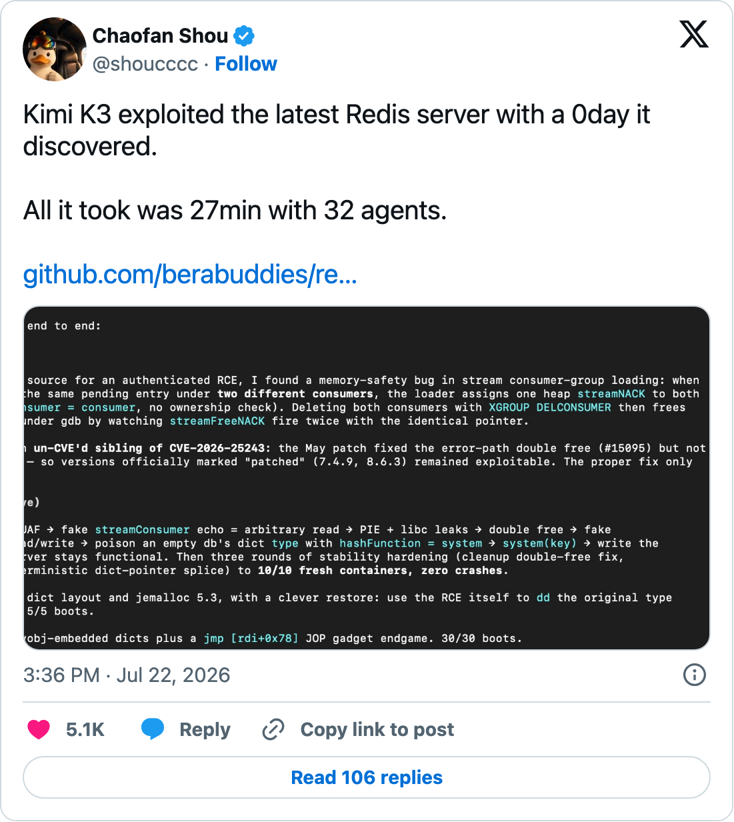
Your next disclosure might be a tweet
Notes:
Your next security vulnerability could be just a tweet, It might not go through the security workflow you had designed.
A security researcher discovered a vulnerability using agents and published a proof of concept all under 30 minutes.
Both the attackers and defenders updated at the same time.

Slide 3
2026 already has more advisories than 2024 and 2025 combined
Source: github.com/valkey-io/valkey/security/advisories
Notes:
And it’s not just that. We’ve observed a increase in advisory in Valkey this year. GitHub published more security advisories this year than the combined advisories from the last two years.

Slide 4
“a seemingly unending deluge of vulnerability reports from researchers using LLMs to mine for security gold in our software”
Jeremy Stanley, OpenStack, oss-security, April 2026
Notes:
This has been the theme of this year. A never ending stream of CVE requests by security researchers.

Slide 5

Finding bugs got easy
script debugger use-after-free
2 weeks
Notes:
Three researchers who didn't know about each other reported the same use-after-free in the script debugger, all inside two weeks. Finding bugs is real cheap now. What follows next is expensive.

Slide 6

Finding got cheap. Everything after it didn't.
find
reproduce
assess
fix
embargo
backport
release
Notes:
Finding is the only step a model made cheap. Every step after it is maintainer judgement or coordination, and none of them scale with the number of reports.

Slide 7
Act 1: CVEs aren't so special anymore

Slide 8
“When everything is a CVE, nothing is”
-Madelyn Olson (Wise Maintainer)
Notes:
The thesis of the act. If every crash gets a CVE, the ones that matter drown in the noise, for us and for every operator reading advisories.

Slide 9
Doing what you're allowed isn't a vulnerability
read another client's keys
execute code
ACL boundary
delete data
grow memory
pin a core with Lua
Notes:
Below the line is what an authenticated client can already do. Above it is what crosses a permission boundary. Out-of-bounds reads cross the line because the leaked bytes can belong to another client. We’re raising the bar for what counts as a CVE.

Slide 10


Raising the bar on CVEs
Advisory
Ordinary bug
Pre-auth crash
Authenticated out-of-bounds read
Memory corruption with a path to code execution
Authenticated crash or hang
Crash from a client with EVAL
Notes:
Prior to this surge anything touching availability, confidentiality, or integrity got an advisory. We are more careful going forward with assigning a CVE to a vulnerability.

Slide 11

The cluster bus trusts every message
clients
6379
6379
6379
16379
16379
node
node
node
16379
nodes only
Notes:
Clients talk to every node on the client port. Nodes talk to each other on the cluster bus, over a different port. The nodes exchange messages between them. It blindly trusts all incoming traffic on this port, there is no application level authentication over the link. It’s the operator’s responsibility to secure it. The connections are to be secured behind private networks or use mutual TLS.

Slide 12

The cluster bus gets hardening instead of CVEs
No CVE
Still hardened
Reaching the bus already means owning the cluster
Bus parsing bugs still get fixed
Mutual TLS with tls-cluster yes
Firewall guidance in the docs
Notes:
An attacker who can reach the bus can already hijack slots, so a crash there gives them nothing new.

Slide 13
Embargoes are now two weeks
before
30 days
now
14 days
Notes:
The default embargo used to be 30 days, that’s too long in the current generation. As I mentioned 3 requests had the same vulnerability discovered all within two weeks. So, we need to get the patch out sooner to users to secure their system

Slide 14

Security is no longer just the TSC
security group
TSC
Notes:
And to get more hands to help with some of the steps after finding the bugs, we have expanded the trusted set of people beyond the maintainers and formed a new security group.

Slide 15
Act 2: Find bugs before they do

Slide 16
Humans only see crashing tests
threat model
Notes:
AI threat generation proposes candidate bugs, then AI review argues against each. Most die at verification: the first model misread the code, or the impact is trivial. The harness is deterministic: crash, ASAN failure, replica desync. If the harness can't tell, the model can't prove it.

Slide 17
Humans only see crashing tests
threat model
AI threat generation
Notes:
AI threat generation proposes candidate bugs, then AI review argues against each. Most die at verification: the first model misread the code, or the impact is trivial. The harness is deterministic: crash, ASAN failure, replica desync. If the harness can't tell, the model can't prove it.

Slide 18
Humans only see crashing tests
threat model
AI threat generation
AI review
Notes:
AI threat generation proposes candidate bugs, then AI review argues against each. Most die at verification: the first model misread the code, or the impact is trivial. The harness is deterministic: crash, ASAN failure, replica desync. If the harness can't tell, the model can't prove it.

Slide 19
Humans only see crashing tests
threat model
AI threat generation
AI review
reproduce in harness
Notes:
AI threat generation proposes candidate bugs, then AI review argues against each. Most die at verification: the first model misread the code, or the impact is trivial. The harness is deterministic: crash, ASAN failure, replica desync. If the harness can't tell, the model can't prove it.

Slide 20
34
real bugs: Valkey, JSON, search, bloom
Source: valkey.io/blog/keeping-up-with-ai-valkey-security
Notes:
Audits run periodically on several frontier models. Goal is before every release.

Slide 21
The TLS use-after-free
listRewind(pending_list, &li);
while ((ln = listNext(&li))) {
tls_connection *conn = listNodeValue(ln);
if (conn->flags & TLS_CONN_FLAG_POSTPONE_UPDATE_STATE) continue;
tlsHandleEvent(conn, AE_READABLE);
processed++;
}
src/tls.c, tlsProcessPendingData(), before the fix
Notes:
listIter caches the next node. tlsHandleEvent can run CLIENT KILL -> freeClient -> connTLSClose -> listDelNode, freeing that cached node. The next listNext() reads freed memory.
The fix pops each connection off the head before handling it, bounded by the length captured on entry. Commit "Fix use-after-free in tlsProcessPendingData() on CLIENT KILL (#4234)", GHSA-53mc-f3m3-99vh.

Slide 22
The TLS use-after-free
next
iterator
A
B
C
Notes:
TLS can decrypt more than one command's worth of data, so connections with unread data go on a list walked once per event loop pass. The walk holds a pointer to the next connection.
The freed object is one the server calls through, so attacker bytes there plausibly mean code execution. That's why it's a CVE under Act 1's rule.

Slide 23
The TLS use-after-free
next
iterator
A
B
C
CLIENT KILL B
Notes:
TLS can decrypt more than one command's worth of data, so connections with unread data go on a list walked once per event loop pass. The walk holds a pointer to the next connection.
The freed object is one the server calls through, so attacker bytes there plausibly mean code execution. That's why it's a CVE under Act 1's rule.

Slide 24
The TLS use-after-free
next
iterator
B
A
C
freed
CLIENT KILL B
Notes:
TLS can decrypt more than one command's worth of data, so connections with unread data go on a list walked once per event loop pass. The walk holds a pointer to the next connection.
The freed object is one the server calls through, so attacker bytes there plausibly mean code execution. That's why it's a CVE under Act 1's rule.

Slide 25

The TLS use-after-free
next
crash
iterator
B
A
C
freed
CLIENT KILL B
Notes:
TLS can decrypt more than one command's worth of data, so connections with unread data go on a list walked once per event loop pass. The walk holds a pointer to the next connection.
The freed object is one the server calls through, so attacker bytes there plausibly mean code execution. That's why it's a CVE under Act 1's rule.

Slide 26

What about Rust?
Notes:
Someone is going to ask. Memory-safe languages are the obvious answer to a use-after-free, so take the question head on.

Slide 27
Rust won't compile it
for conn in server.tls_pending.iter() {
if conn.postpone { continue; }
server.handle_event(conn); // CLIENT KILL removes from tls_pending
}
Notes:
Same loop as the C. handle_event needs &mut server because it can remove from the list, and the iterator already holds a borrow of it. Checked with rustc --edition 2021; the error is real output, wrapped to fit.
The version that compiles is the shape of the C fix: pop_front() each connection, bounded by the length on entry. The compiler forces the fix that took us a CVE to find.

Slide 28
Rust won't compile it
for conn in server.tls_pending.iter() {
if conn.postpone { continue; }
server.handle_event(conn); // CLIENT KILL removes from tls_pending
}
error[E0502]: cannot borrow `*server` as mutable
because it is also borrowed as immutable
Notes:
Same loop as the C. handle_event needs &mut server because it can remove from the list, and the iterator already holds a borrow of it. Checked with rustc --edition 2021; the error is real output, wrapped to fit.
The version that compiles is the shape of the C fix: pop_front() each connection, bounded by the length on entry. The compiler forces the fix that took us a CVE to find.

Slide 29
Rust removes some bugs
Use after free
Access out of bounds
Panics
Hangs
Logic bugs
Notes:
The TLS bug was a use after free, and safe Rust won't compile it. Out-of-bounds access is checked at runtime: it becomes a panic, so no leaked bytes, but still a crash. Panics, hangs, and a permission check in the wrong place all still ship.

Slide 30
Act 3: React fast

Slide 31
AI triages every report first
advisory
incoming report
AI triage
ordinary bug
not reproducible
Notes:
Triage is codified as prompts, per the Valkey blog. AI reproduces the report against the target build and sorts it with the Act 1 rule before a maintainer spends time on it. Only advisories go to the maintainer queue as security work.
TODO: confirm the triage steps and outcomes with how Valkey actually runs it.

Slide 32


Both labs run security programs for defenders
Cyber Verification Program
Trusted Access for Cyber
Vetted defenders get its strongest models
portal.anthropic.com/programs/cvp/apply
Verified access to cyber-capable models
openai.com/index/trusted-access-for-cyber
Notes:
Anthropic: the Cyber Verification Program, expanded 6 October 2026. For security teams, critical infrastructure operators, open-source maintainers, red teams and pen-testers. Vetted defenders get Opus 5.5, Sonnet 5.5 and Mythos 5.1 with fewer cyber blocks, in three tiers: Defense Access, Red Team Access, Specialized Access. anthropic.com/news/cyber-verification-program
OpenAI: Trusted Access for Cyber, 5 February 2026. An identity and trust-based framework for access to its most cyber-capable models, with $10M in API credits and the Cybersecurity Grant Program.

Slide 33

Same-day fixes on every branch
A year ago
Now
Hand cherry-pick into every branch
AI backport PRs, conflicts resolved
Notes:
Triage and release steps are codified as prompts. Goal is a zero-day fix shipped the same day.

Slide 34
Five release branches in 72 minutes
9.1 · 17:03
7.2 · 17:04
unstable · 16:03
backport sweep
9.0 · 17:11
8.1 · 17:12
8.0 · 17:15
github.com/valkey-io/valkey, PRs #4234 to #4242, 21 July 2026, UTC
Notes:
The TLS fix, #4234, merged to unstable at 16:03 UTC on 21 July. The valkey-ci-agent bot opened backport sweeps from 16:05. All five release branches had it merged by 17:15. The same bot opened release-note PRs for 7.2.14, 8.0.10, 8.1.9, 9.0.5 and 9.1.1, all merged by 23:39. One fix, five releases, one day.
7.2 needed an adapted fix: it lacks a flag the fix uses. The bot kept the security change, dropped the part that didn't apply, and flagged it for review on #4242.

Slide 35
Fix to five published releases in under eight hours
fix merged
backport sweep
backports merged
release notes
releases published
downstream updates
16:03
16:05
17:15
17:23
23:41
00:08
valkey-io/valkey, valkey-hashes, valkey-container, valkey-io.github.io, 21 to 22 July 2026, UTC
Notes:
Blue is automation, rose is a person. Bots opened the backport sweeps and the release-note PRs for 7.2.14, 8.0.10, 8.1.9, 9.0.5 and 9.1.1. A maintainer published the five releases between 21:35 and 23:41. Each publish triggered the release automation: hashes updated within a minute, and container and website PRs opened, all merged by 00:08 on 22 July.
Fix merged to five releases published: 7 hours 38 minutes.

Slide 36
Humans review the changes.
Notes:
Automation writes the backport. A person is accountable for it, more so in a security release.

Slide 37

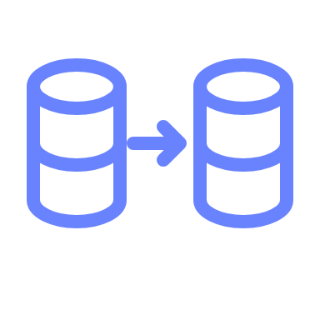
Recap
Act 1
Act 2
Act 3
CVEs aren't so special anymore
Advisories are for crossing a boundary
Find bugs before they do
Adversarial audits that end in a crashing test
React fast
Same-day backports that humans review
Notes:
Operators: stay on current patches and make consuming updates routine; follow the hardening guide. Researchers: email security@lists.valkey.io with a reproducer against the target build, ideally with a fix. Maintainers: build the harness, write the policy, automate the backports.

Slide 38
Assume bug-finding keeps getting cheaper.
Notes:
Plan for it. Every process in this talk is built on that assumption. Getting these tools to maintainers is what keeps open source secure.

Slide 39

Getting involved
Read the post: valkey.io/blog
Report: security@lists.valkey.io
Harden: valkey.io/blog/properly-secure-your-valkey-deployment
Notes:
The QR goes to the security post, which links the hardening guide.

Slide 40
Thank you! Let’s connect.
Madelyn Olson
Harkrishn Patro
@reconditerose (X and Bluesky)
@buntyhp (X)
madelynolson.com
linkedin.com/in/harkrishn-patro
linkedin.com/in/madelyn-olson-valkey

